Slide 1

Emergency Room Performance Analysis
By Bhumi Limbachiya

Slide 2







Problem Statement
The Emergency Room Performance Dashboard analyzes key metrics such as patient volume, demographics, wait times, and satisfaction scores to identify bottlenecks and improve operational efficiency.

Slide 3

Key Questions Answered
1. What are the busiest day and time for ER visits?
2. What is the average wait time by department, weekday, and hour?
3. How do patient satisfaction scores vary by age, gender, and race?
4. How are patients distributed across age groups and time periods?
5. What is the trend of patient visits over time?

Slide 4

Steps to Create the Dashboard
1. Data Gathering: Imported ER data.
2. Transformation: Created new 'Hour' column, merged names, cleaned data, and updated data types.
3. DAX Measures: Created Date Table, Satisfaction Parameter, and metrics for Busiest Day/Time.
4. Visuals: Built charts to display trends, distributions, and satisfaction scores.
5. Bookmarks/Page Navigator: Added functionality to switch between visuals for patient trends and wait times.

Slide 5

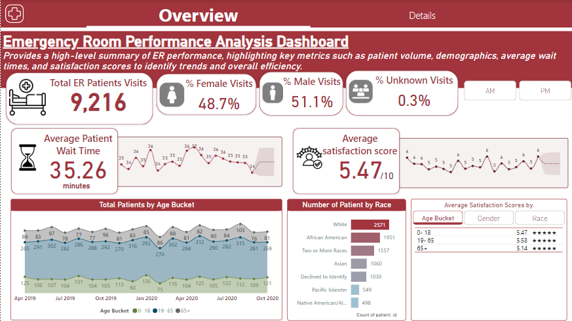
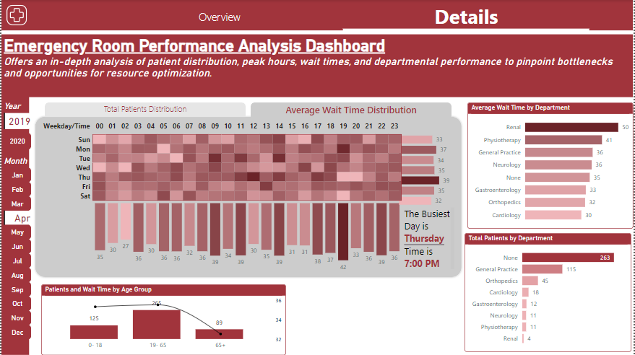
Dashboard

Slide 6






Insights from Dashboard
1. Busiest Day/Time : Monday at 11:00 PM has the highest patient volume.
2. Average Wait Time : Neurology has the highest wait time (37 minutes).
3. Satisfaction Scores : Varies significantly by race, with African Americans having the lowest scores.
4. Patient Distribution : The majority of patients are in the 19-65 age group.
5. Trends : Total patient visits have remained consistent with fluctuations during certain months.

